Slide 1
Software Development on Java
Dzmitry Marchankau 2023

Slide 2
Multithreading
Multithreading in Java
Concurrency
Asynchronous calls

Slide 3
Multithreading and multitasking
Multithreading is a concept of running multiple threads simultaneously. Thread is a lightweight unit of a process that executes in multithreading environment.
Multithreading reduces the CPU idle time that increase overall performance of the system.
Multitasking is a process of performing multiple tasks simultaneously.
Multitasking can be achieved either by using multiprocessing or multithreading.

Slide 4
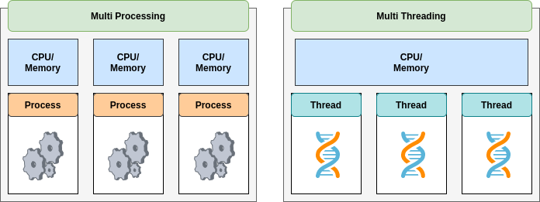
Multithreading and multitasking

Slide 5
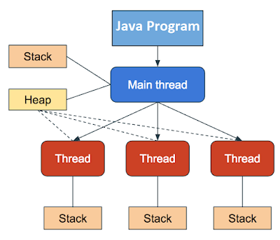
Multithreading in Java

Slide 6
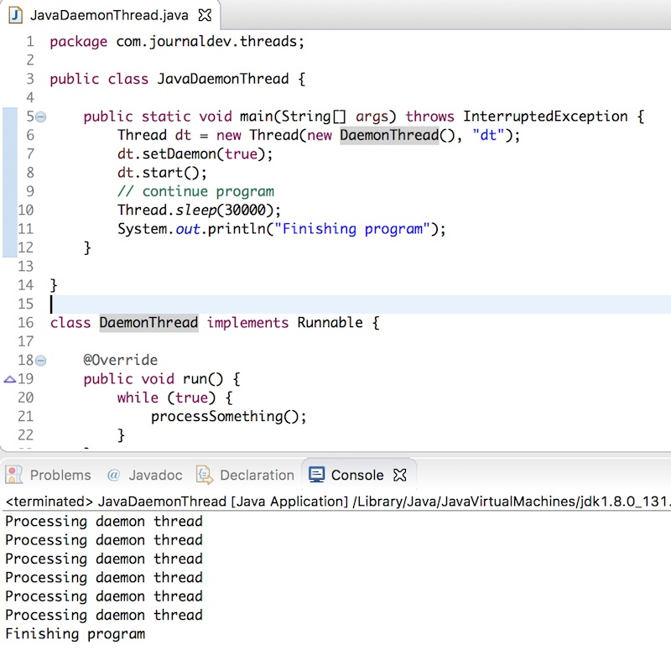
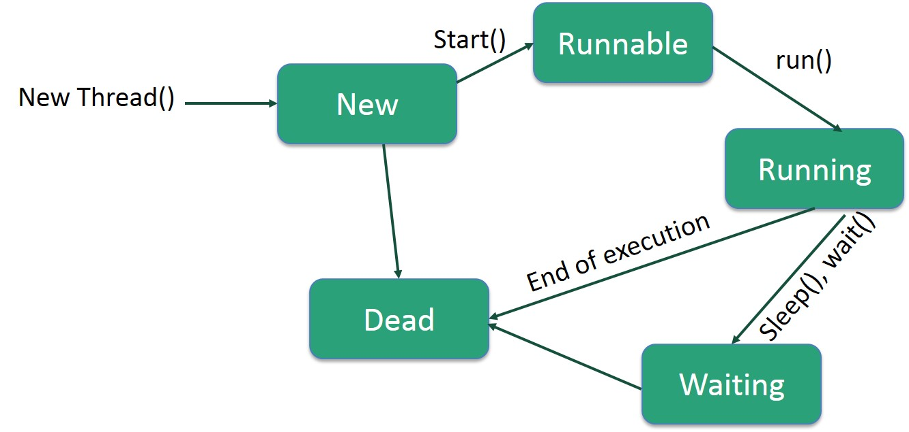
Threads in Java

Slide 7
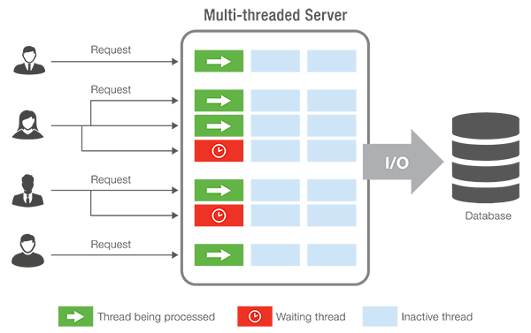
Multithreading in enterprise apps

Slide 8
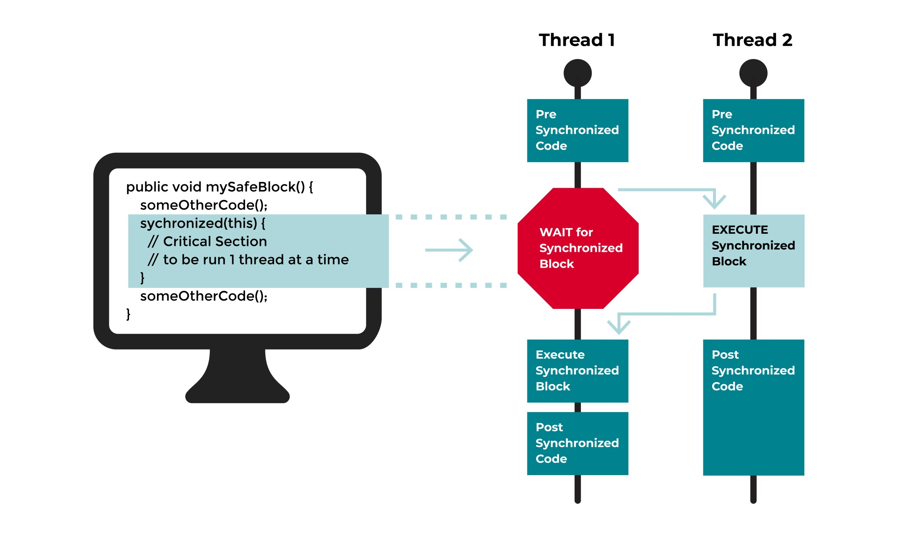
Synchronization in Java

Slide 9
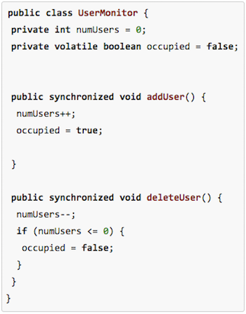
Synchronized methods

Slide 10
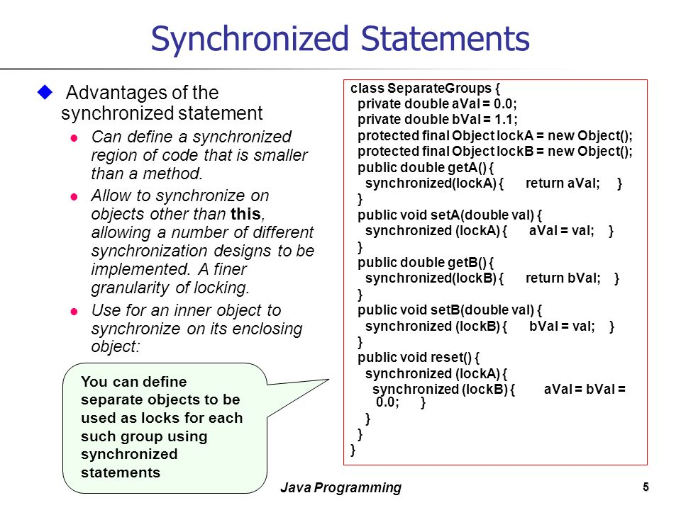
Synchronized statements

Slide 11
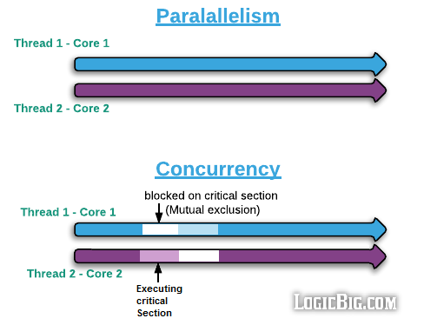
Concurrency and parallelism

Slide 12
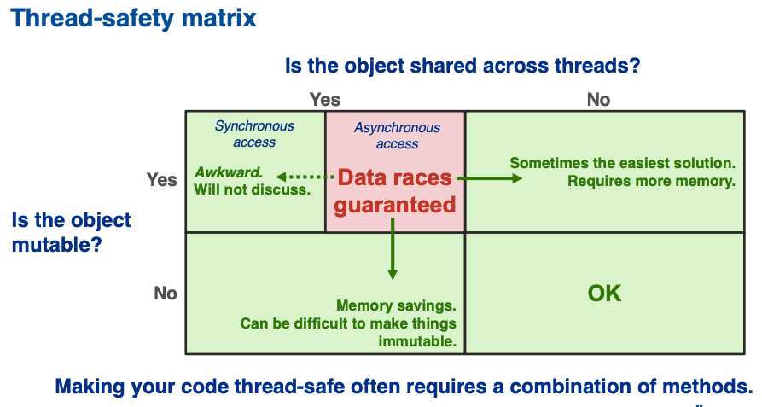
Thread safety

Slide 13
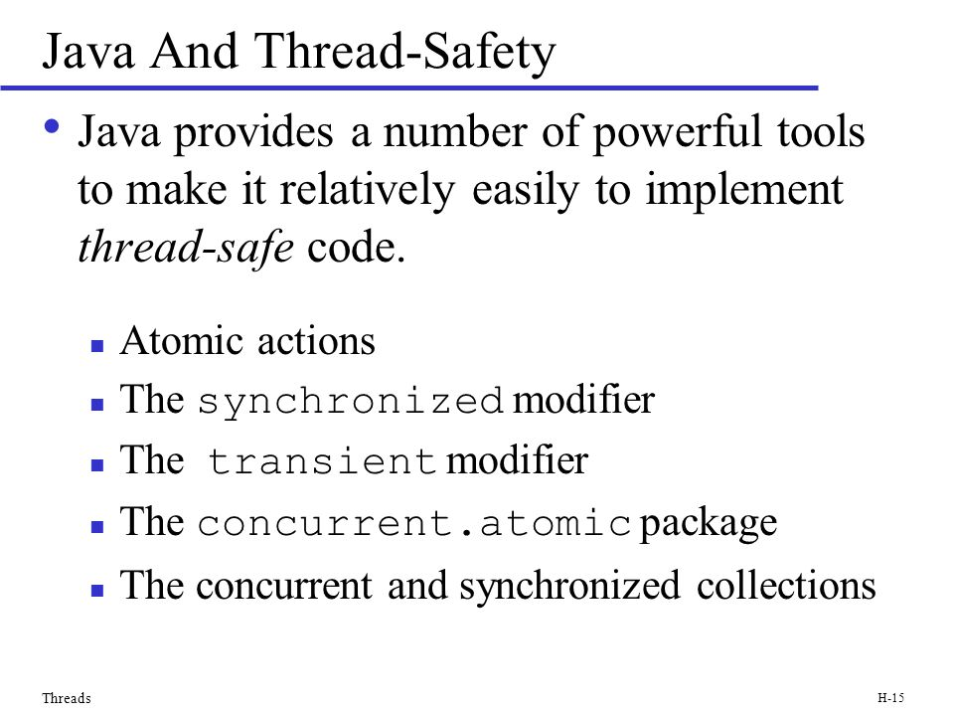
Thread safety in Java
Notes:
Volatile modifier may be better fit instead of transient

Slide 14
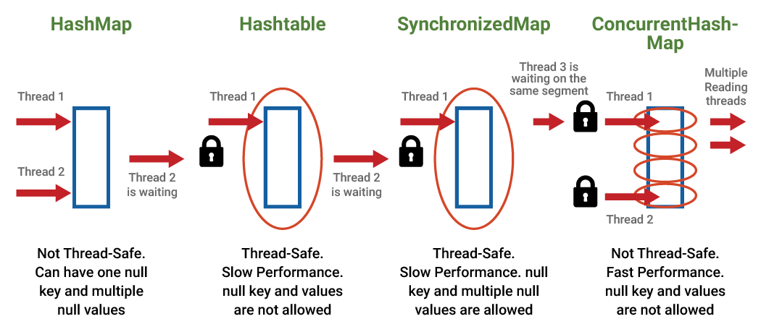
Concurrent collections

Slide 15
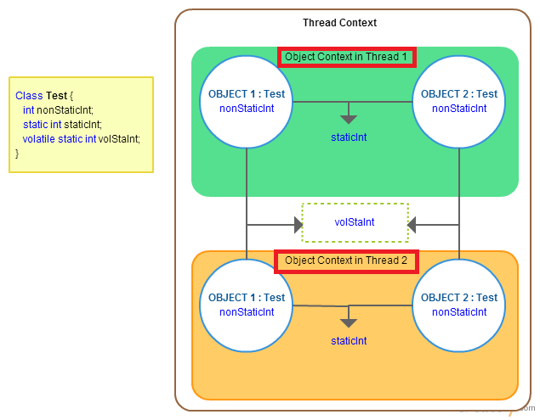
Volatile modifier

Slide 16
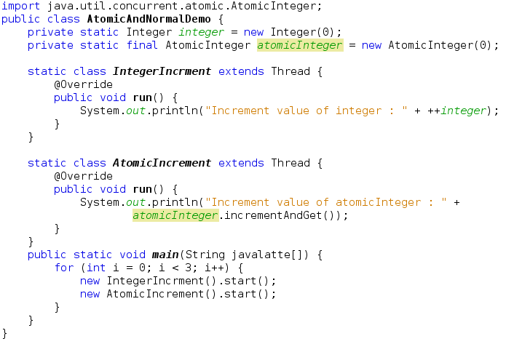
Atomic package usage

Slide 17
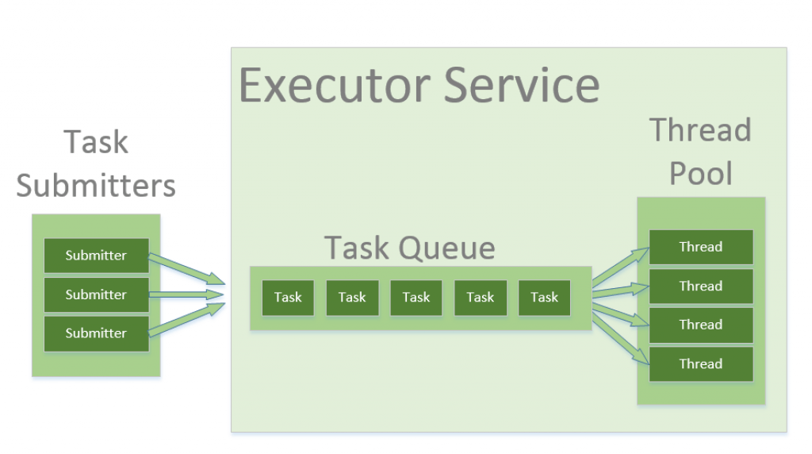
Thread pool

Slide 18
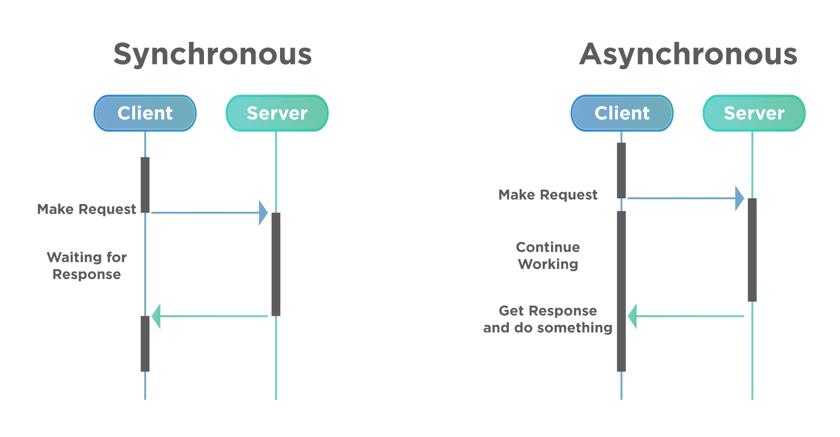
Asynchronous calls

Slide 19
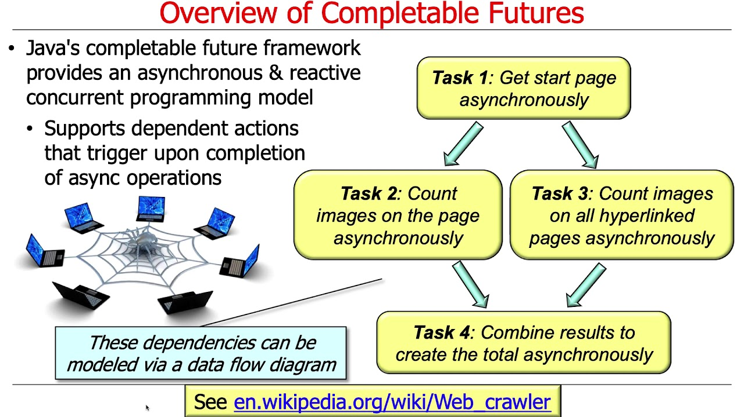
Completable Future

Slide 20
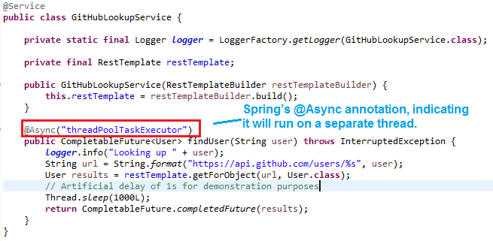
Completable Future example

Slide 21
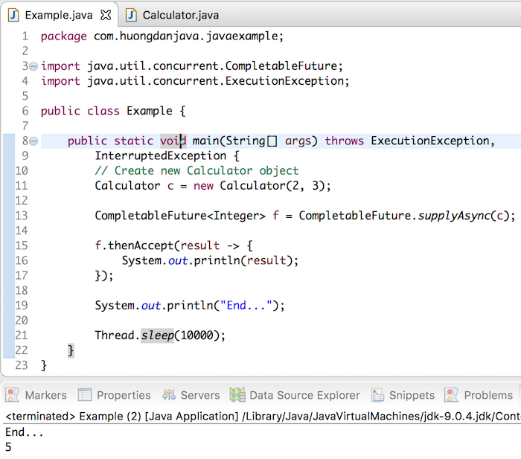
Completable Future example

Slide 22
Questions ?

